Slide 1
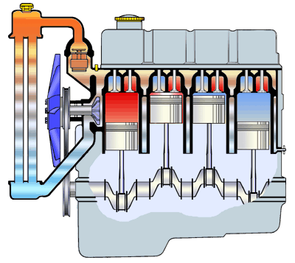
Cooling System
Get the engine up to optimum operating Temperature as quickly as possible and
maintains it at that temperature.
Controls the heat produced in combustion chamber, so that the engine parts
are not damaged & the oil does not break down.

Slide 2
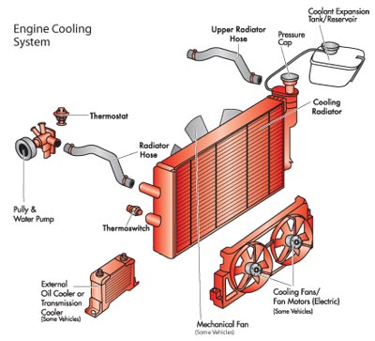
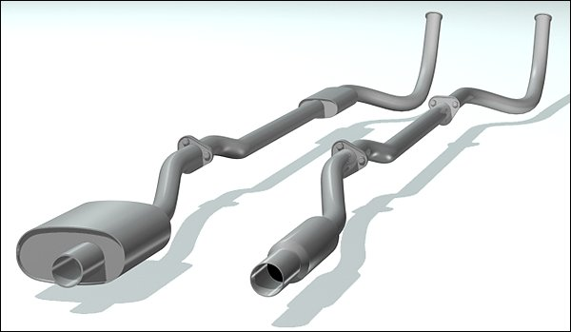

Cooling System
TOTAL FUEL BURNED
1/3 cooling system
1/3 Exhaust system
1/3 Propels the vehicle

Slide 3
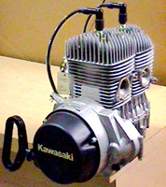
Cooling System
AIR COOLED
Have metal FINS on the outer perimeter
of the engine.
Heat is transferred from the engine,
through these fins, into the atmosphere.

Slide 4

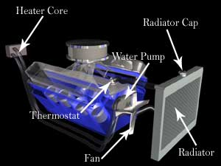
Cooling System
LIQUID COOLED
A liquid (coolant) is circulated around the cylinders and absorb heat from the
cylinder walls and cylinder head.
COOLANT is a mixture of antifreeze (Ethylene Glycol) and
Water (some Aluminum radiators have special antifreeze)
Coolant absorbs heat as it passes through the engine and also
lubricates the water pump.
Hot coolant enters the radiator in which the heat
is passed on to air that is flowing
through the radiator.
Prevents rust and corrosion from the water jackets.
Cooling system flush is recommended every two years
in order to remove any rust or contaminants.

Slide 5
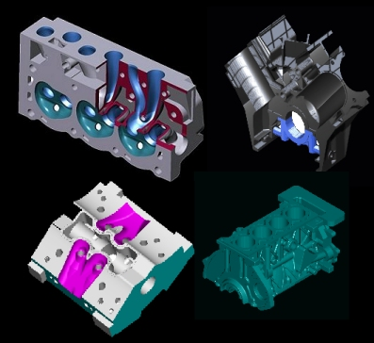
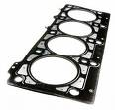
Cooling System
Water Jackets
Designed to keep engine block and cylinder head
cool.
Open spaces between the outside of cylinder and
inside of cylinder block and head.
When engine is running at normal operating
temperature, the coolant is forced through the
water jackets in the engine block, through the
head gasket, into the head, and back to the
radiator.
Cylinder head gasket sits between the short block and cylinder head.
If damaged, the coolant enters the combustion chamber and
the combustion into the cooling system. It will allow acids to form.
(WHITE SMOKE)

Slide 6
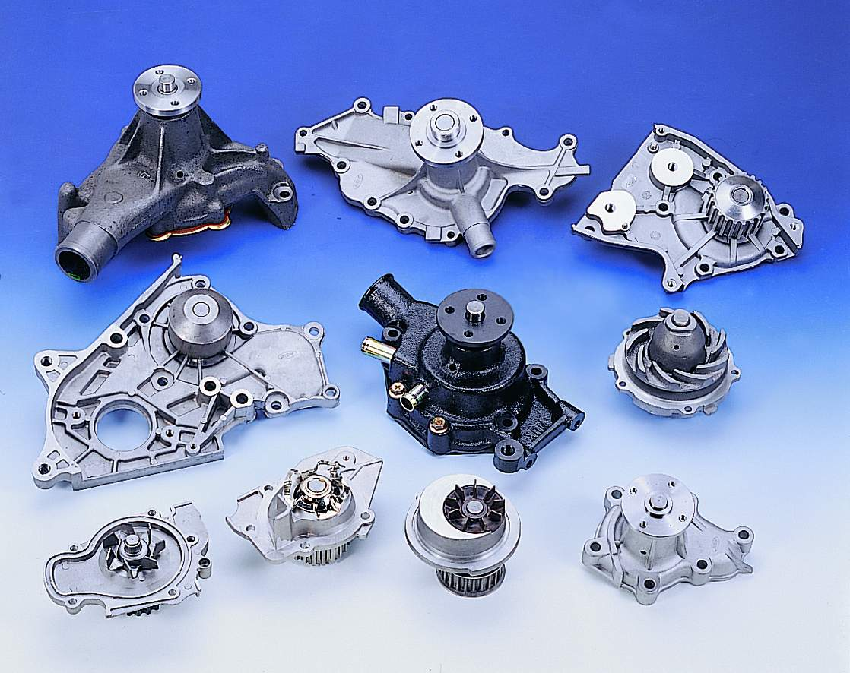

Cooling System
Water Pump (Impeller Type)
Draws the coolant from the radiator,
through the lower radiator hose, and
then forces it through the water jackets,
back into the radiator.
If the clutch fan can be wiggled up and
down, most likely the water pump needs
to be replaced.
Water pumps gasket is placed between
the water pump and the engine block to
prevent leakage 9if left loose it might leak
and if tightened too much it might crack).

Slide 7
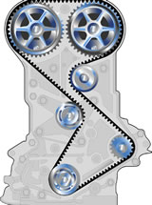
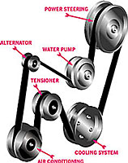
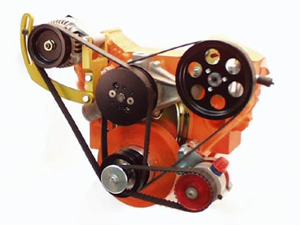
Cooling System
Water pump is driven by the crankshaft through
Timing Belt (Keeps Cam and Crank shafts in time)
Drive/accessory Belt (Runs alternator, power-steering
pump, AC, etc.)
V-Belt
Serpentine Belt

Slide 8
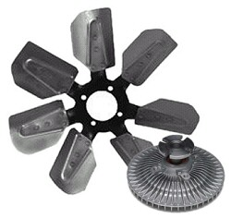
Cooling System
Engine Fan draws air through the radiator at low speeds (i.e. Traffic)
Clutch fan is mounted on the water pump and
is driven by the drive belt.
It slips at higher speed, in turn slowing the fan
speed down.
It locks up at slow speeds, in turn speeding
up the fan RPMs.
Should be able to turn when the engine is turned off.

Slide 9
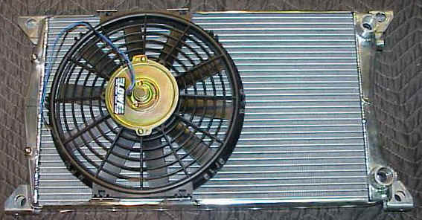
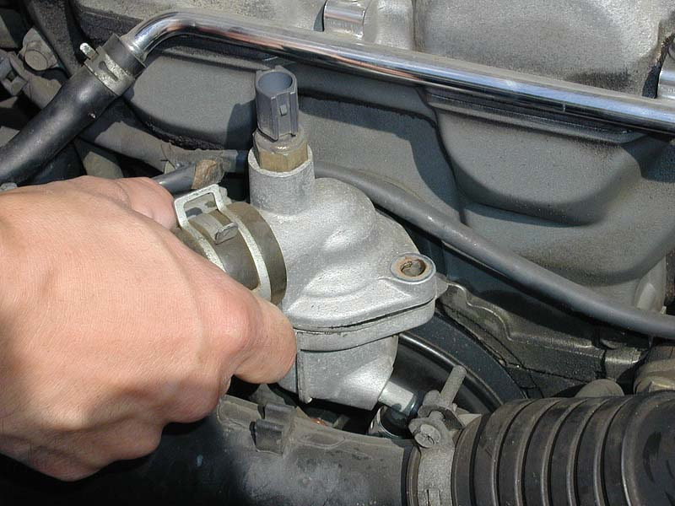
Cooling System
Electric fan is mounted on the radiator
and is operated by battery power.
Is controlled by the thermostat switch.
Is located on Thermostat housing, Block, or Radiator.
Some modern cars have the range between
193º to 207º F (89 to 97º C)
On AC equipped cars, a second fan is mounted,
and it runs any time AC is turned on.
CAUTION Electric fan may run while the
engine is turned off.

Slide 10
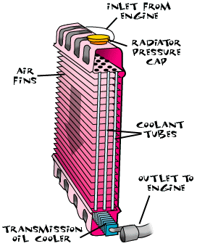
Cooling System
Radiator is a heat exchanger that removes heat from the coolant passing
through it.
Vertical or Horizontal core
Vehicles equipped with automatic transmission
have transmission cooler build into the radiator.
Some vehicles (towing purposes) have oil cooler
mounted to “or” build into the radiator.

Slide 11
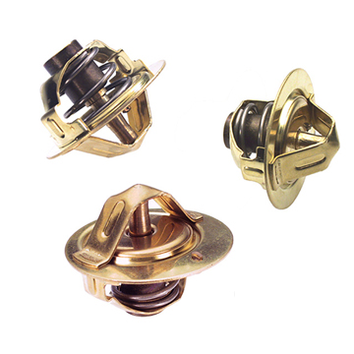
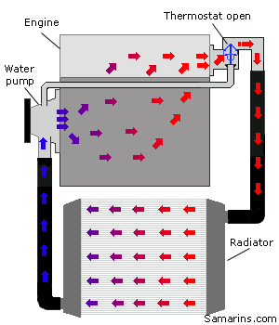
Cooling System
Thermostat placed between the cylinder head and top radiator hose.
Purpose is to close off this passage when engine is cold.
The temperature that the thermostat opens is
called thermostat rating.
Higher temperature
thermostats are used
on the modern vehicles.
If thermostat is stuck open the engine will run cool,
and if the thermostat is stuck closed the engine will
Overheat.
Can be checked by placing in the boiling water.

Slide 12
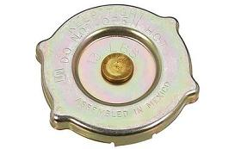
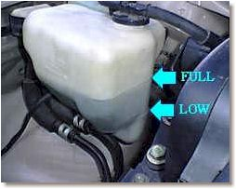
Cooling System
Radiator Pressure cap seals the cooling
system and pressurize it.
Most caps insert 12-16 lbs of pressure.
Each pound of pressure inserted increases the boiling
point of coolant by 1.8º C (3º F).
Boiling point of water is 100º C (212º F).
Has a built in pressure relief valve to prevent excessive pressure build-up.
Has a vacuum vent valve (when engine is shut off and it cools, the coolant volume
is reduced)
Excess coolant goes to the expansion tank.
CAUTION never open the radiator cap if you
can’t squeeze the top radiator hose.

Slide 13
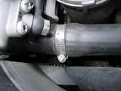
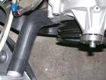
Cooling System
Hoses
Top Radiator hose brings the coolant back to the radiator and are molded
Specifically for individual make and model.
Lower radiator hose draws the coolant into the
engine, from the radiator and is attached to the
water pump. (sometimes a spring is inserted in
order to prevent collapsing)

Slide 14
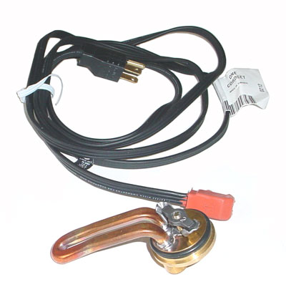
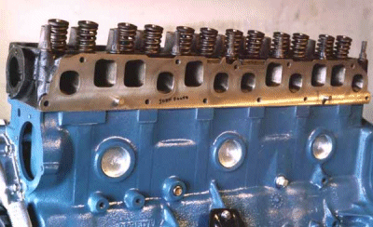
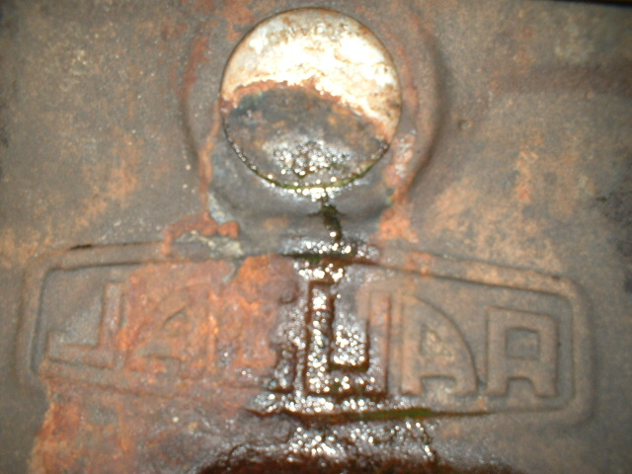
Cooling System
BLOCK HEATER
Fitted into the block to keep the engine
warm during extremely cold weather.
(Diesel Engines)
FREEZE PLUG
Prevents engine block cracking
if water freezes inside.
Common cause of freeze plug failure is
rust.

Slide 15
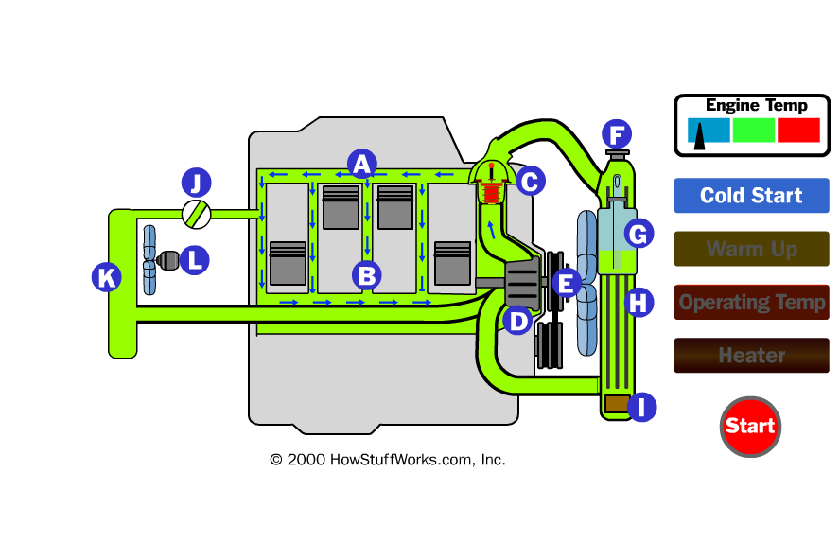

Cooling System

Slide 16
Cooling System
Credits
Pictures taken from google search engine and “How stuff works”

